Slide 1
Task Management
Created By:
Razan Hayajneh
Heba Al-jedayah
Supervided By:
Dr. Ahmad Alsalem

Slide 2
TABLE OF CONTENTS
01
04
Overview
Admin App Demo
02
05
Methodology
Task Manager App Demo
03
06
RESTfull API
Challenages

Slide 3
Overview

Slide 4
02
Methodology

Slide 5
Task Management
GoDaddy Server(CPanel Hosting)
http://taskmanagement.schooldemos.com/
For Database and Backend, using Laravel framework (PHP)
For Frontend:
Using Nodejs for admin application
Using Flutter for team member application

Slide 6
03
RESTfull API

Slide 7
RESTful APIs work
The user sends a request to the server.
The server authenticates the user and confirms that has the right to make that request
The server receives the request
The server returns a response to the user with the requested information if the request is successful

Slide 8
RESTful API request
Method:
GET|POST|PUT|DELETE
HTTP headers:
Data: POST|PUT
Parameters: URL|
Authentication Methods:
Basic authentication: login/register
Bearer authentication: any other API such as get projects

Slide 9
RESTful API server response
Status line:
200: Generic success response
404: Resource not found
500: Server Error
Message body:
JSON formats: using in flutter project

Slide 10
WEB APIs
Method | URI | Name | Action
GET|HEAD | login | login | Laravel\Fortify\Http\Controllers\AuthenticatedSessionController@create
POST | login | login | Laravel\Fortify\Http\Controllers\AuthenticatedSessionController@store
GET|HEAD | forgot-password | password.request | Laravel\Fortify\Http\Controllers\PasswordResetLinkController@create
POST | forgot-password | password.email | Laravel\Fortify\Http\Controllers\PasswordResetLinkController@store
GET|HEAD | reset-password/{token} | password.reset | Laravel\Fortify\Http\Controllers\NewPasswordController@create
PUT | user/password | user-password.update | Laravel\Fortify\Http\Controllers\PasswordController@update
POST | logout | logout | Laravel\Fortify\Http\Controllers\AuthenticatedSessionController@destroy
GET|HEAD | dashboard | profile.show | App\Http\Controllers\Admin\DashboardController@index
GET|HEAD | profile |  | Closure
GET|HEAD | admins | admins.index | App\Http\Controllers\Admin\AdminController@index
POST | admins | admins.store | App\Http\Controllers\Admin\AdminController@store
GET|HEAD | admins/create | admins.create | App\Http\Controllers\Admin\AdminController@create
GET|HEAD | admins/{ admin }/ edit | admins.edit | App\Http\Controllers\Admin\AdminController@edit
PUT|PATCH | admins/{ admin } | admins.update | App\Http\Controllers\Admin\AdminController@update
DELETE | admins/{ admin } | admins.destroy | App\Http\Controllers\Admin\AdminController@destroy

Slide 11
WEB APIs
Method | URI | Name | Action
GET|HEAD | teamMembers | teamMembers.index | App\Http\Controllers\Admin\TeamMemberController@index
GET|HEAD | teamMembers/{teamMember}/ edit | teamMembers.edit | App\Http\Controllers\Admin\TeamMemberController@edit
PUT|PATCH | teamMembers/{ teamMember } | teamMembers.update | App\Http\Controllers\Admin\TeamMemberController@update
DELETE | teamMembers/{ teamMember } | teamMembers.destroy | App\Http\Controllers\Admin\TeamMemberController@destroy
GET|HEAD | categories | categories.index | App\Http\Controllers\Admin\TaskCategoryController@index
POST | categories | categories.store | App\Http\Controllers\Admin\TaskCategoryController@store
GET|HEAD | categories/create | categories.create | App\Http\Controllers\Admin\TaskCategoryController@create
GET|HEAD | categories/{category}/ edit | categories.edit | App\Http\Controllers\Admin\TaskCategoryController@edit
PUT|PATCH | categories/{category} | categories.update | App\Http\Controllers\Admin\TaskCategoryController@update
DELETE | categories/{category} | categories.destroy | App\Http\Controllers\Admin\TaskCategoryController@destroy

Slide 12
APPLICATION APIs
Method | URI | Action
POST | api/v1/register | App\Http\Controllers\API\AuthAPIController@register
POST | api/v1/login | App\Http\Controllers\API\AuthAPIController@login
POST | api/v1/ logout | App\Http\Controllers\API\AuthAPIController@logout
GET|HEAD | api/v1/get-profile-info | App\Http\Controllers\API\ProfileAPIController@show
POST | api/v1/ update-profile-info | App\Http\Controllers\API\ProfileAPIController@update
POST | api/v1/update-profile-image | App\Http\Controllers\API\ProfileAPIController@updateImage
GET|HEAD | api/v1/projects | App\Http\Controllers\API\ProjectAPIController@index
POST | api/v1/projects | App\Http\Controllers\API\ProjectAPIController@store
GET|HEAD | api/v1/projects/{project} | App\Http\Controllers\API\ProjectAPIController@show
PUT|PATCH | api/v1/projects/{project} | App\Http\Controllers\API\ProjectAPIController@update
DELETE | api/v1/projects | App\Http\Controllers\API\ProjectAPIController@destroy
GET|HEAD | api/v1/project-members | App\Http\Controllers\API\ ProjectMemberAPIController@index
POST | api/v1/project-members | App\Http\Controllers\API\ProjectMemberAPIController@store
DELETE | api/v1/project-members/{project_member} | App\Http\Controllers\API\ProjectMemberAPIController@destroy
GET|HEAD | api/v1/ task-categories | App\Http\Controllers\API\ TaskCategoryAPIController@index
GET|HEAD | api/v1/tasks?project_id={id} | App\Http\Controllers\API\ TaskAPIController@index
POST | api/v1/ tasks?project_id={id} | App\Http\Controllers\API\ TaskAPIController @store
GET|HEAD | api/v1/ tasks/{task} | App\Http\Controllers\API\ TaskAPIController @show
PUT|PATCH | api/v1/ tasks/{ task} | App\Http\Controllers\API\ TaskAPIController @update
DELETE | api/v1/ tasks/{ task} | App\Http\Controllers\API\ TaskAPIController@destroy

Slide 13
APPLICATION APIs
Method | URI | Action
GET|HEAD | api/v1/my-tasks | App\Http\Controllers\API\MyTasksAPIController@index
GET|HEAD | api/v1/task-status/{id} | App\Http\Controllers\API\TaskAPIController@updateStatus
GET|HEAD | api/v1/ task-members | App\Http\Controllers\API\ TaskMemberAPIController@index
POST | api/v1/ task-members | App\Http\Controllers\API\ TaskMemberAPIController@store
DELETE | api/v1/ task-members/{ task_member} | App\Http\Controllers\API\ TaskMemberAPIController@destroy
GET|HEAD | api/v1/getCountOfFinishedTaskInProject | App\Http\Controllers\API\TaskCountAPIController@getCountOfFinishedTaskInProject
GET|HEAD | api/v1/getCountOfTaskInProject | App\Http\Controllers\API\TaskCountAPIController@getCountOfTaskInProject
GET|HEAD | api/v1/timelines?task_id={id} | App\Http\Controllers\API\TimelineAPIController@index
GET|HEAD | api/v1/ reports?task_id={id} | App\Http\Controllers\API\ ReportAPIController@index
POST | api/v1/ reports?task_id={id} | App\Http\Controllers\API\ ReportAPIController @store
GET|HEAD | api/v1/ reports/{report} | App\Http\Controllers\API\ ReportAPIController @show
PUT|PATCH | api/v1/ reports/{report} | App\Http\Controllers\API\ ReportAPIController @update
DELETE | api/v1/ reports/{report} | App\Http\Controllers\API\ ReportAPIController@destroy
GET|HEAD | api/v1/notifications | App\Http\Controllers\API\NotificationAPIController@index
POST | api/v1/notifications | App\Http\Controllers\API\NotificationAPIController@store

Slide 14
04
Admin App Demo

Slide 15
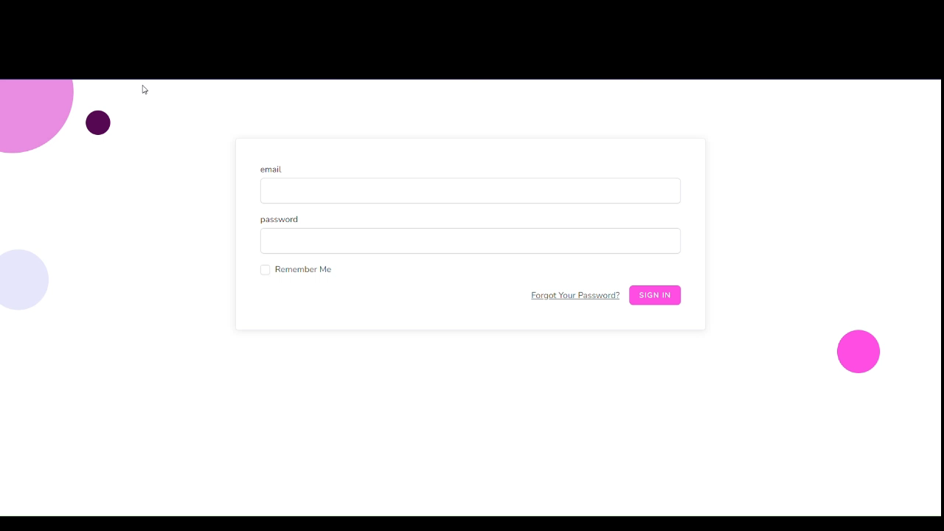

Slide 16
05
Task Manager App Demo

Slide 18
06
Challenages

